Slide 1
ACCU Trainees introduction to AHP services at RLH
May 2021

Slide 2
Physiotherapy Service
Monday – Friday (8.00am – 6.00pm)
Weekends: Same hours but reduced number of staff. We see respiratory priorities only
Oncall Physiotherapy is available via switch board outside of these times
Staffing:
8 Physios
Referrals:
Blanket referral system across all 44 beds
Discussed at bedside with nurses if not therapy needs

Slide 3
ACCU Physiotherapy Pods
Office on 4E – Opposite SR35
4F MDT office
Pod Leads/Escalations
Sally Kalsi and Musie Tsehaye, Dect:45874
Pods:
A side – #1141
B side – #1515
C side – #1607
*Morning handovers: reflective of 4E+4F boards*

Slide 4
Main roles
Respiratory Interventions
Trachy and vent weaning
Majority will be classed as simple weans [not all need a plan]
Therapy led wean plans for difficult/prolonged wean
Discuss wean with MDT
Sputum clearance/CADs
Respiratory muscle training
Rehabilitation interventions
Aim for at least 3 x p/w
Early mobilisation emphasis/ERAS and supportive to nursing colleagues
Secondary complications management e.g. ICUAW/TBI/NMD cohorts
Weekends: Limited
Patient White boards (with SLT and Nursing staff)
Patient centred management (Resp, Positioning, Personal)
Personal history sheets
Tracheostomy Ward Round

Slide 5
AHP-ACCU Interactions
Morning AHP-ICU Consultant catch ups
Occurs daily at 8:30 at 4E/4F MDT Offices
PT/SLT/Dietician/Medics
Tracheostomy Ward Round
Consultant Anesthetist and MDT
Tuesdays at 11:30/12
ACCU Patient MDM
Discuss all patients ≥10 days with all MDT
Adapted PICUPS
Thursdays at 2 – 4pm, 4F Meeting Room 2
Delirium Ward Round
Tuesdays 1:30
Led by Julia Hadley (ICU Cons) and Polly (Psychologist)

Slide 6
Projects about to take off in Physio on ACCU
Physio
Standardising our SAH protocol and EVD policy
Tracheostomy Weaning plans
Post surgical standards London wide
Respiratory muscle training
TCO2 monitoring of NMD weaning patients for nocturnal hypoventilation and impact on ACCU

Slide 7
Dietetic Service
Monday – Friday (8am-4pm)
Bank Holiday Cover (subject to change)
Staff
Anne Langan (Lead)
Chloe Jarvis and Emily Templeman
Referrals:
Prioritisation (blanket referral system)
PN service

Slide 8
Referrals & Prioritisation
Blanket referral system in place
Patients usually seen on Day 2-3 of admission
Day 3-4 for lower priority patients.
ALL Patients requiring TPN need to have a referral completed on CRS
Not sure if patient requires TPN -> ask for Dietitian Review prior to PN referral.
Notes:
Blanket referral system depends on us being at full staffing. Please call us or tell us about any patients that you think need a review.
We prioritise the patients we see based on a brief review of CRS and by attending our Tuesday morning handover. There might be a patient that you would like to be seen sooner – if this is the case let us know and we can re-prioritise our caseload accordingly.

Slide 9
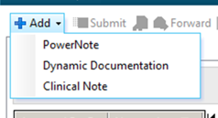
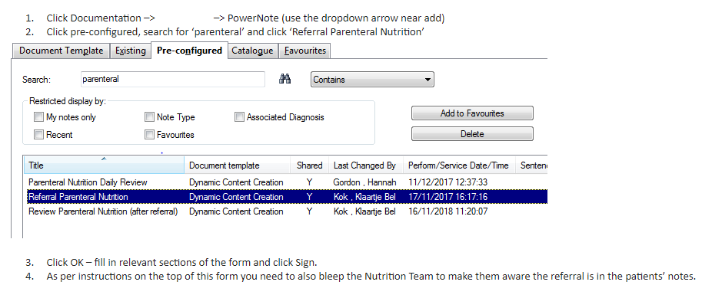
Referral for TPN

Slide 10
Parenteral Nutrition Service
PN on ACCU is reviewed by the ACCU Dietitians with adhoc input from the Nutrition Team
Nutrition Team:
Dr. Kok/Dr. Glynn (Consultant Gastroenterologists)
Gastro SpR
PN Pharmacist
Nutrition CNS - #42223
Nutrition Specialist Dietitian (Provides PN cover for ACCU PN Pt’s)
Ward Rounds: Mon / Wed / Fri (am)
Referrals to be completed prior to 11am
Out of hours PN available (need referral to Gastro SpR on call and on-call pharmacist)
Notes:
We are working to make the out of hours PN process easier.

Slide 11
Parenteral Nutrition
Ideally require dedicated lumen on CVC
Always save a lumen if potential to require PN
Bags arrive to unit early evening (~ 6pm)
Off the shelf bags (some require Cernevit and Addaven prescription)
Electrolyte free and Custom bags available if required
Infused over 24hrs on ICU (often 18hrs or less on ward)

Slide 12
Prioritisation
Priority 1
Priority 2
Parenteral Nutrition
Intubated and ventilated
On feeding protocol for 48-72hrs
Poor tolerance of enteral feeding
Patients on high doses of propofol
High risk refeeding syndrome
Self ventilating and on NG feed
Poor oral intake (likely to require enteral feeding or on supplementary enteral feeding)
Specific dietary advice (low K+ diet, high stoma output, Creon advice)

Slide 13
Enteral Feeding
NGT insertion policy
Updated July 2020 in response to incidents
pH < 5 (first line) – please note initial testing phase
If CXR required, Radiology to confirm position
Tubes can be confirmed out of hours (9-5) if deemed ‘urgent’ by Consultant
Available on WeShare and Box

Slide 14
Enteral Feeding Protocol
Revised recently and in use since Monday
Feeds: Fresubin Original / Fresubin 2kcal HP
(takes into consideration kcal from propofol + refeeding risk)
Refeeding Risk: Pabrinex I&II OD for 3 days, followed by Thiamine 100mg TDS and Vitamin B co-strong 1 tablet TDS.
GRV revised upwards from 250ml to 350ml
Prokinetics:
Metoclopramide 10mg IV TDS (5mg IV TDS for < 60kg) up to 5 days.
Erythromycin IV 250mg BD (up to 5 days)
Discuss with Dietitians re NJT feeding/ TPN

Slide 15
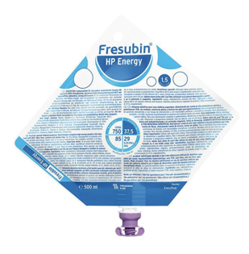
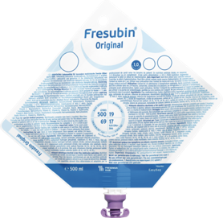
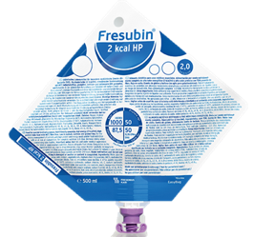
Most common feeds used on ACCU
ICU Protocol Feed
1kcal/ml
3.8g protein/ 100ml
Most commonly used feed
1.5kcal/ml
7.5g protein / 100ml
Low volume low electrolyte feed
2kcal/ml
10g protein / 100ml

Slide 16
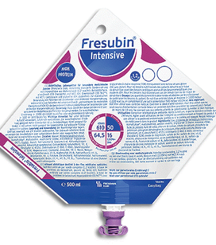
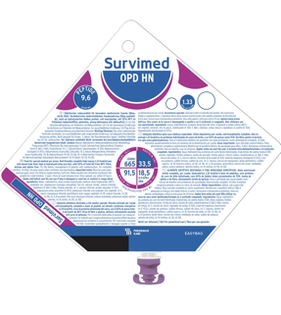
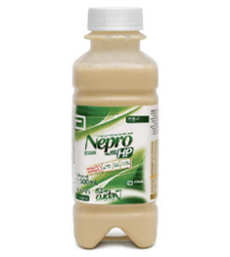
Other feeds used
Low Calorie, High Protein
1.22kcal/ml
10g protein / 100ml
Semi-elemental feed
1.33kcal/ml
6.7g protein/100ml
Low volume, low electrolyte
Slightly lower in K+ than Fresubin 2kcal HP (rarely used)

Slide 17
Oral Nutrition Supplements (ONS)
200ml
400kcal
20g protein
200ml
300kcal
8g protein
High Carbohydrate
Fat module
5kcal/ml
Often used with Intensive feed
125ml
300kcal
18g protein
Low K+

Slide 18
Contact Details
Bleeps: 1033, 1653
Extension 41129
Nutrition CNS: 1164

Slide 19
Speech and Language Therapy on ACCU
Royal London Hospital

Slide 20
SLT service
Monday – Friday (8.00am – 4.00pm)
Weekends: No weekend service
Staffing:
3 SLTs
We cover the videofluoroscopy clinic and FEES for the whole hospital
Referrals:
CRS
Via consultant meeting on Tuesday mornings
Verbal referrals on the unit or by phone

Slide 21
Role of SLT on ACCU
We see all patients, Neurological, surgical and medical for the following;
1. Dysphagia:
Neurological
Structural
Laryngectomy
Post extubation*
ITU acquired weakness*
Cognitive behavioural
Patients with respiratory dysfunction
Medications
Secretion management
Tracheostomy
- Initial cuff deflation with PT colleagues for patients on ventilated or when on TM
- Upper airway assessment
- Secretion management
- Voice and swallow assessment
Communication:
- Aphasia
- Apraxia
- Dysarthria
- Cognitive communication disorders
- AAC for intubated patients/patients with cuff inflated (and unable to wean).
- Support capacity assessments
Notes:
*Swallow screening – only to be carried out by nurses, Drs or AHPs. NOT for pt’s who have neurology, spinal injury or premorbid swallowing difficulties.* IF IN DOUBT JUST REFER
Dysphagia (complex and often multifactorial in ACCU population)
Neurological: CN V, VII,IX,IX & X, XII, brainstem/cortical changes, seizures, spinal injuries
Structural i.e. ACDF, VC palsy, spinal surgery, pharyngeal pouch etc.
Laryngectomy - *Head and Neck team*
Post extubation*
ITU acquired weakness*
Cognitive behavioural (unable to self feed, bolus holding, poor awareness of task etc)
Patients with respiratory dysfunction (e.g. COPD, ARDs, chest trauma or high O2 requirements)
Medications
SECRETION MANAGMENT
Communication:
- Aphasia
- Apraxia
- Dysarthria
- Cognitive communication disorders (fewer than 50% of patients with CCD are referred to SLT)
- Assessments for AAC for intubated patients/patients with cuff inflated (and unable to wean).
- Support capacity assessments
3. Tracheostomy
Initial cuff deflation; trust guidelines and GPICS state that SLT should be involved with all tracheostomy weaning
On vent – (A-L Sutt research may aid lung recruitment)
Assess upper airway competence/patency, secretion management, swallow function, voice, communication, need for AAC, considerations for Above Cuff Vocalisation.
Post extubation - Research variable –from 3-62%, higher rate of silent aspiration, correlation between increased length of time with ETT and increased risk of dysphagia
*COVID patients are particularly at risk due to inflammatory process, long intubation times, complex respiratory weans and long ITU stays
Other:
Attend Trache ward round
Attend LTBR
Project work to improve care etc
Response Time:
Dysphagia/Trache 24 hours
Communication 48 hours
We do not have blanket referrals – reliant on MDT to refer via CRS
Swallow screen available on CRS
We aim to see patients between 1-3 sessions per week dependent on need

Slide 22
Role of SLT on ACCU continued
Instrumental assessment:
Fibreoptic Endoscopic Evaluation of Swallow (FEES)
Videofluoroscopy (VFS)
Palliative care
Eating and drinking at risk
Disorder of Consciousness :
Commencing CRS-R/WHIM assessments

Slide 23
SLT team
X2 B7 Robyn Cary and Eileen Kelly
X1 B6 Ellie Jones
As a small hospital wide team we also cross cover other streams dependent on need
*Specialist Head and Neck team; Maria Trajkov and Megan Odell*
Notes:
Head and Neck team – they are running training for the nurses 03/09/2020 re. laryngectomy. Speak to Nuala (PDN) and you might be able to join. Or if more of you want to organise separate training just contact Freya directly.

Slide 24
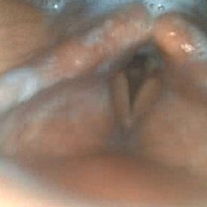
Fibreoptic Endoscopic Evaluation of Swallow (FEES)
Notes:
Tracheostomy
Secretion management
Swallow
Voice – although ENT FNE would be first line of referral if nil swallow concerns

Slide 25
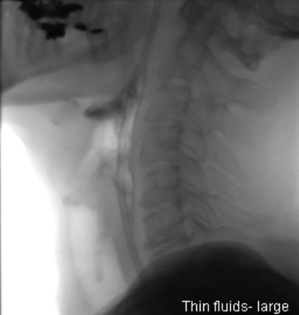
Videofluoroscopy (VFS)

Slide 26
How to contact us
Therapies office (same as PT)
X41140 or bleep #1877 or 1281
Refer via CRS
Specialist Head and Neck SLT team
x41185
#1385
07547 671 474

Slide 27
Questions…..

Slide 28
Moving forwards – Medics IST
What training topics if ANY would you like on your new rota from us?
Previous topics by AHPS:
Trachy weaning – Joint SLT/PT
Nutrition overview – Dietietics
Anything else?????

